Slide 1
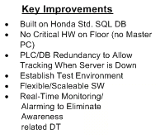
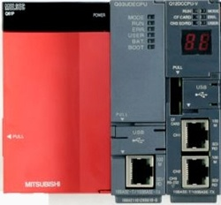
MES Module
Event Driven Transactions
Buffered Data
No “Gateway” PLC
Fast Transactions
Speaks custom protocols - JSON
Java Proxy Server
Triggered Paging

